Slide 1


J.P Morgan Go-Green Race
By Arshvir, Jude, Manik, Murray, Nifemi and Sarah

Slide 2
Overview
Our idea is to create a system in which employees can compete against one another through recycling, running, cycling and walking.
The idea that we have is the Go-Green race, where employees on each floor of both JP Morgan buildings recycle correctly and gain points for doing so and employees can trade points for more snacks.
These points will be displayed on a Go-Green app, an extended web page of an already used J.P. website and possibly displayed on the TVs on each floor and the floor with the most points at the end of the year will win a prize.

Slide 3
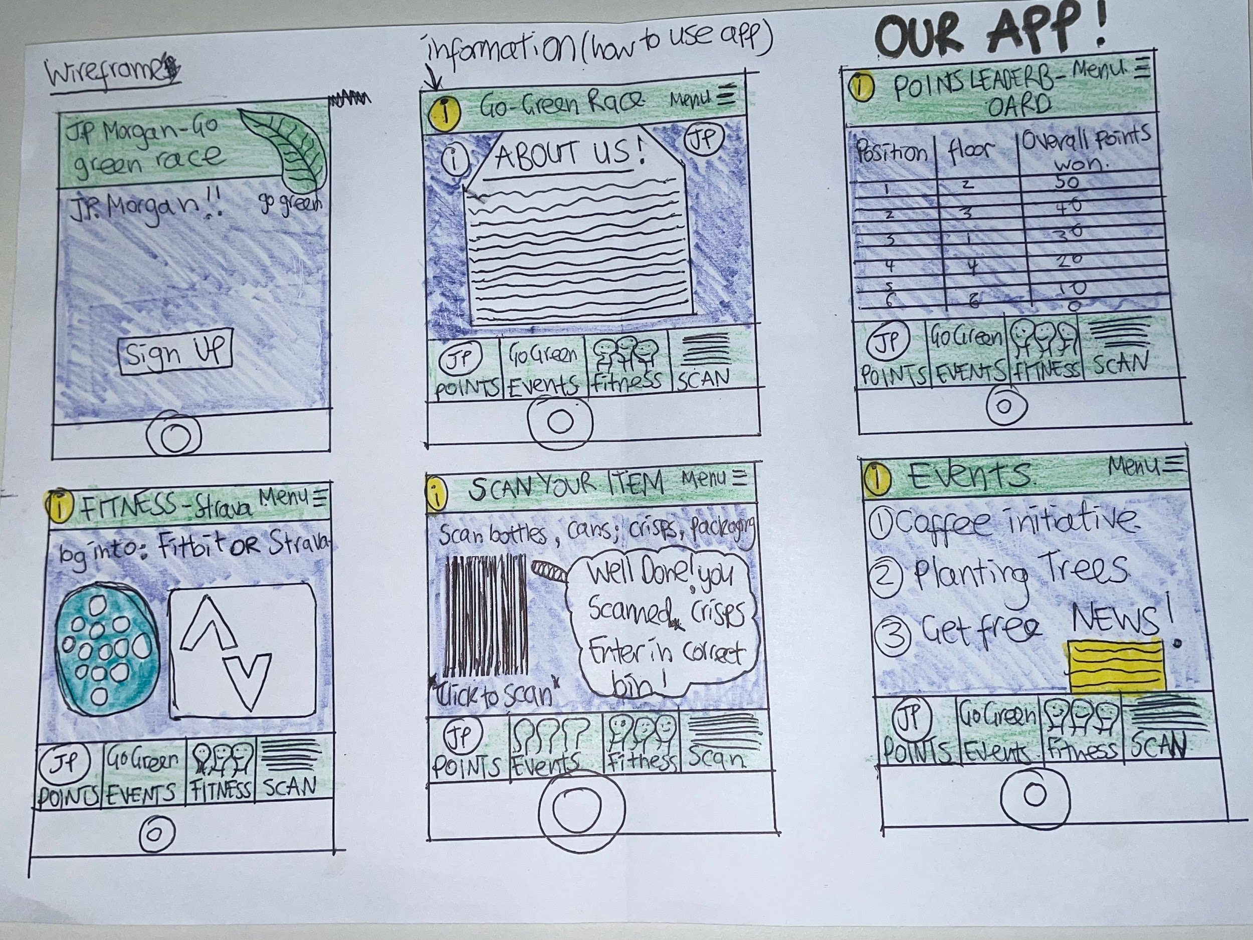
GoGreen App

Slide 4
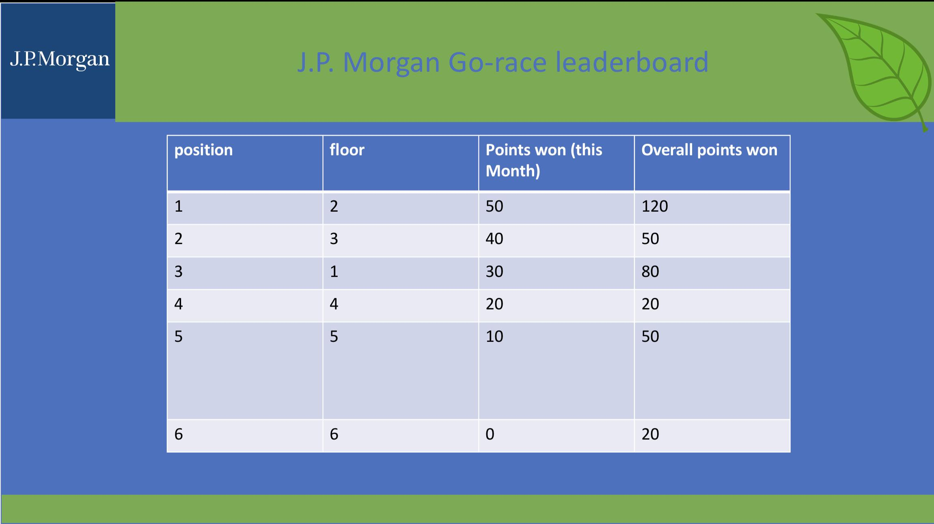
Leaderboard

Slide 5
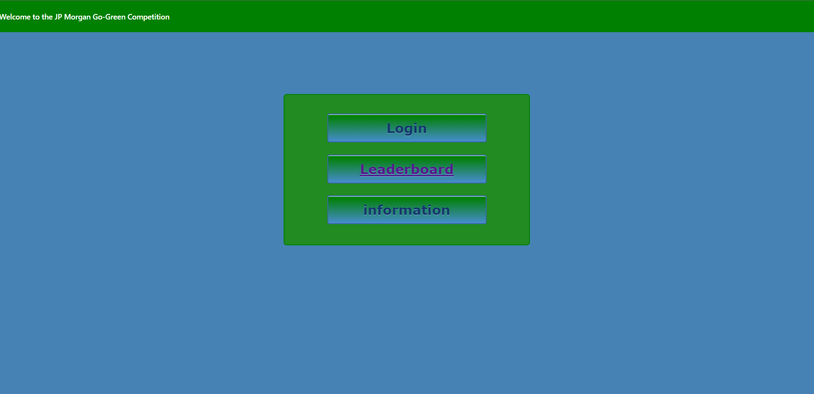
website

Slide 6
Leaderboard

Slide 7
website

Slide 8
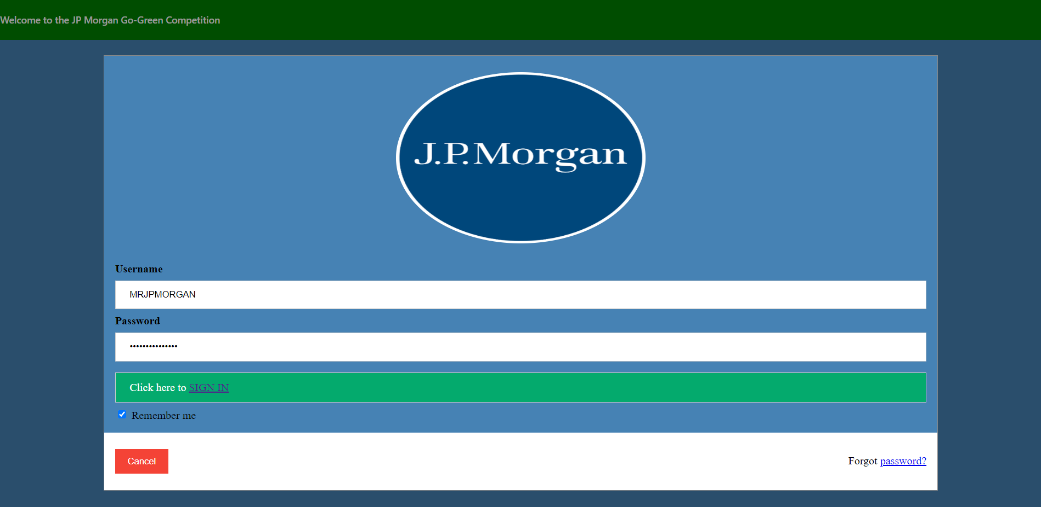

Slide 9
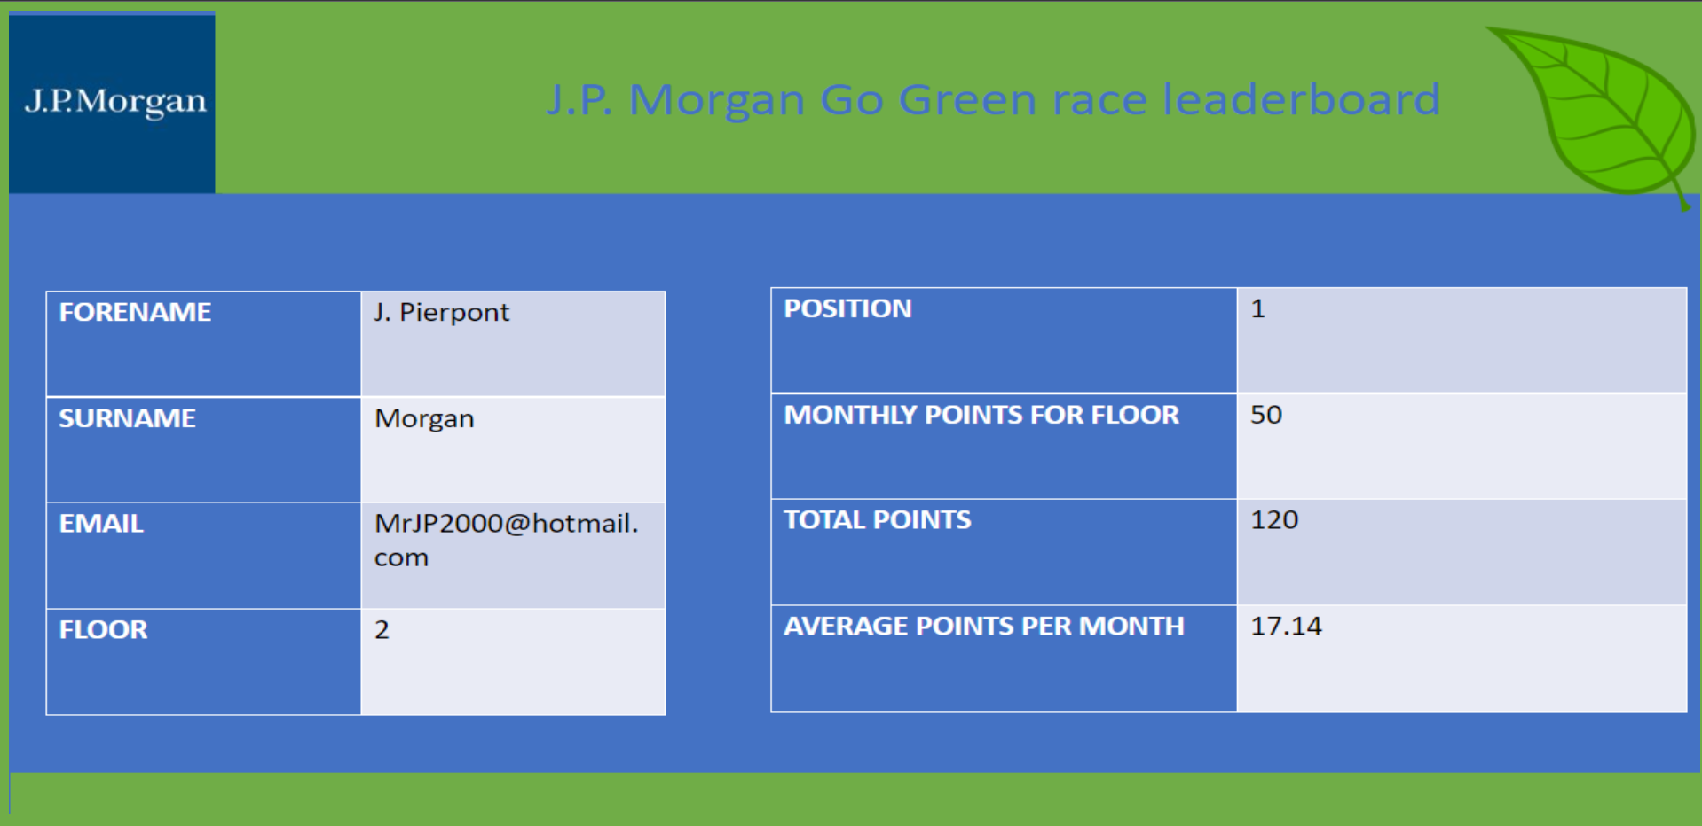

Slide 10
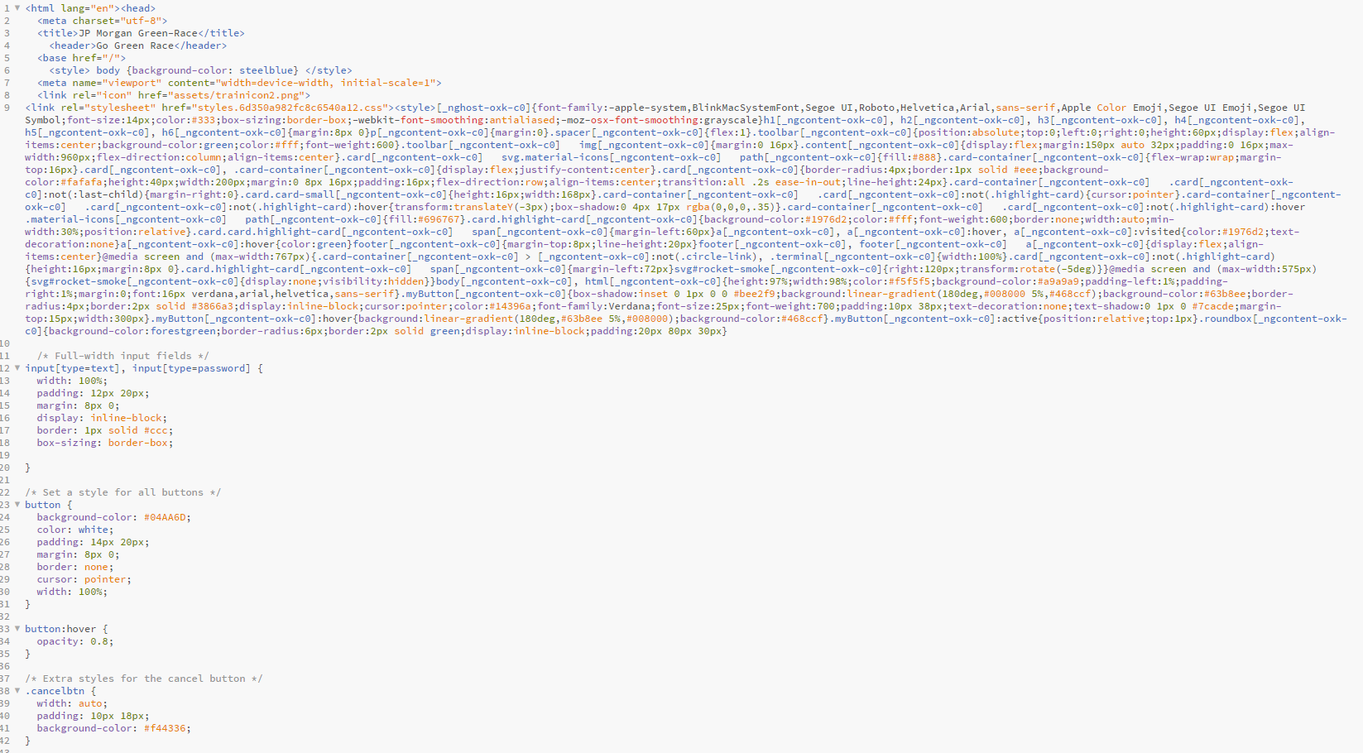

Slide 11
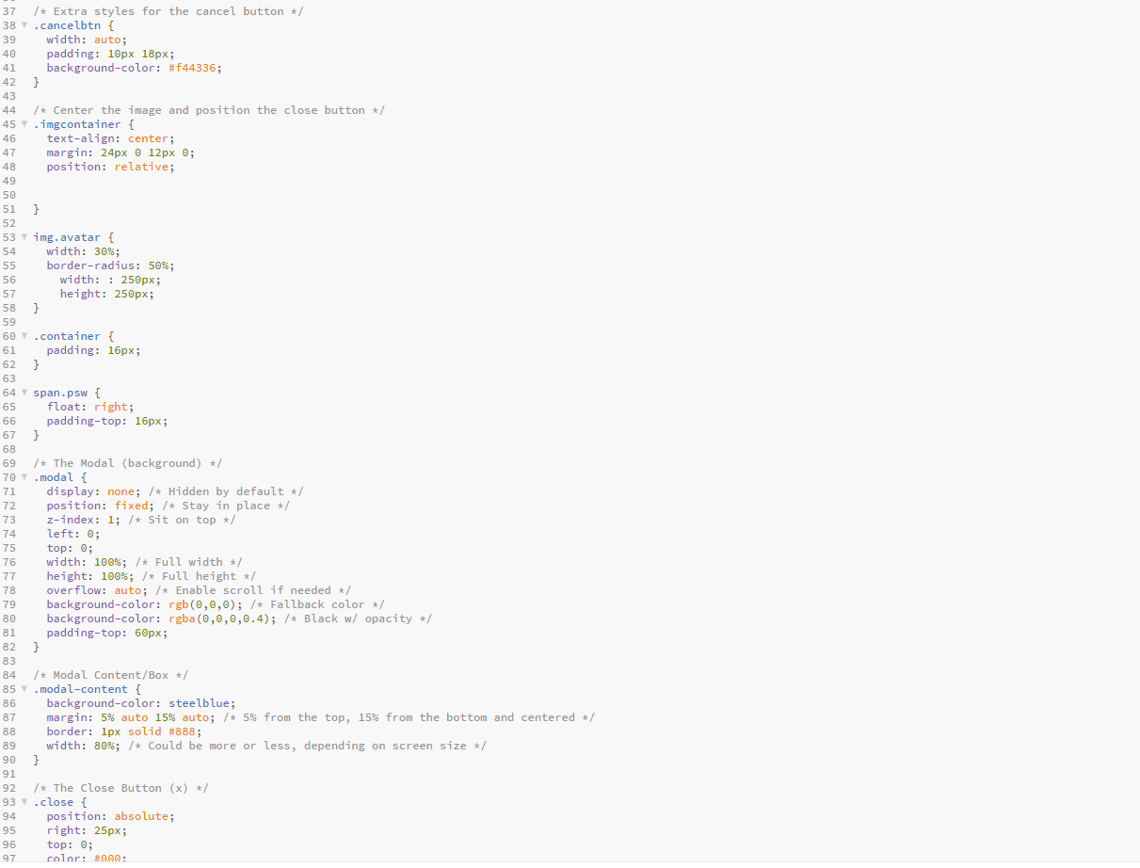

Slide 12
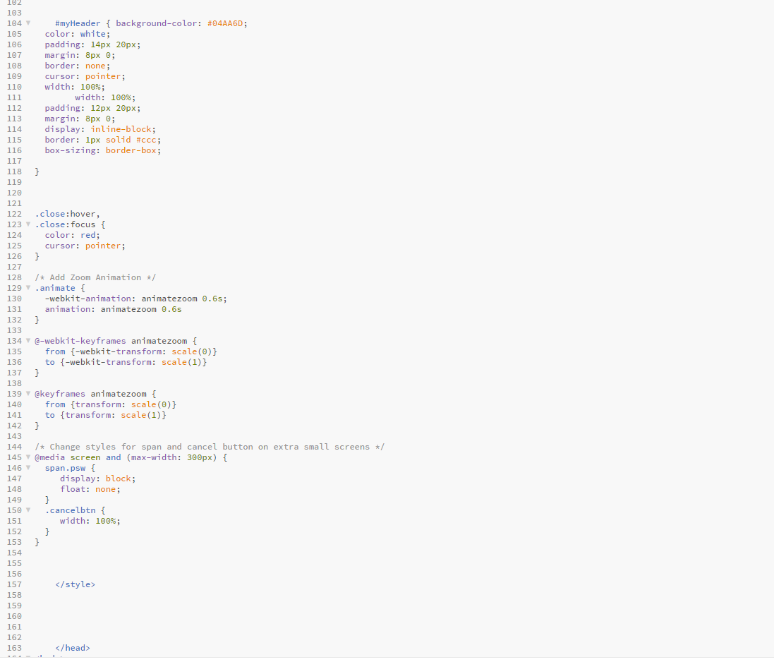

Slide 13
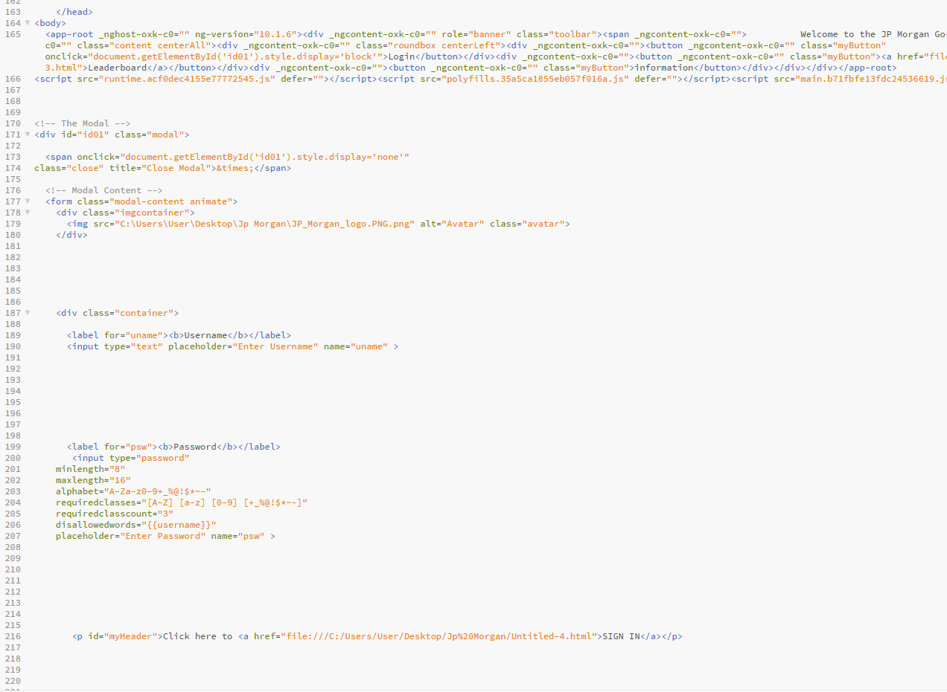

Slide 14
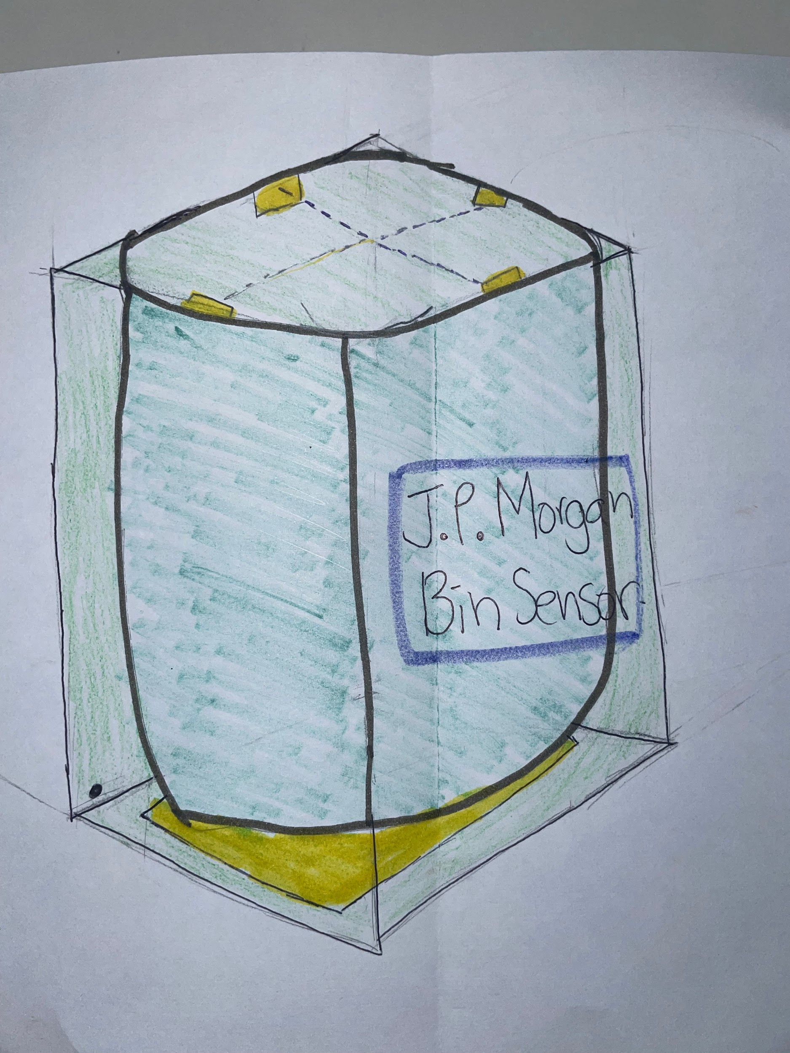
Our Recycling Bin Initiative
Educating, engaging and forward thinking

Slide 15
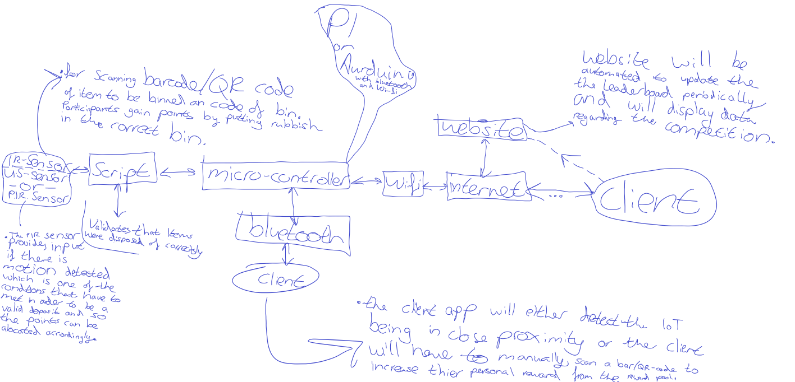
Networking

Slide 16
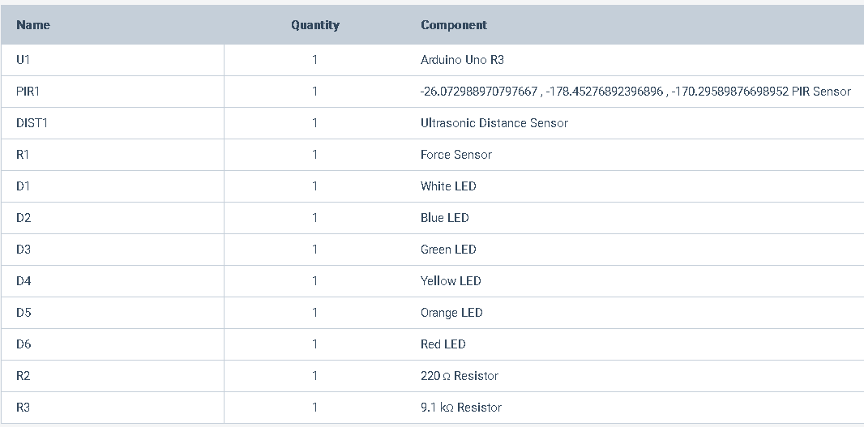
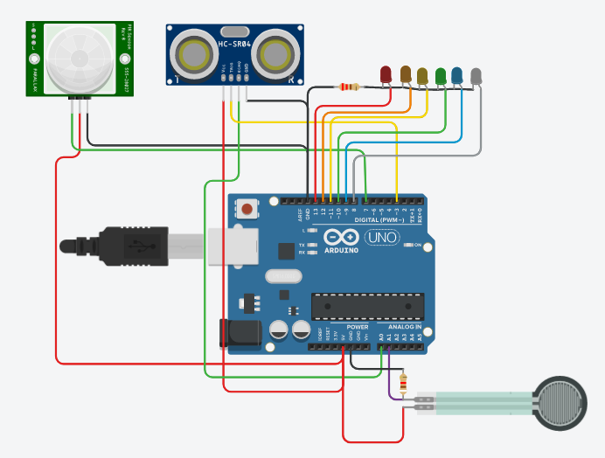
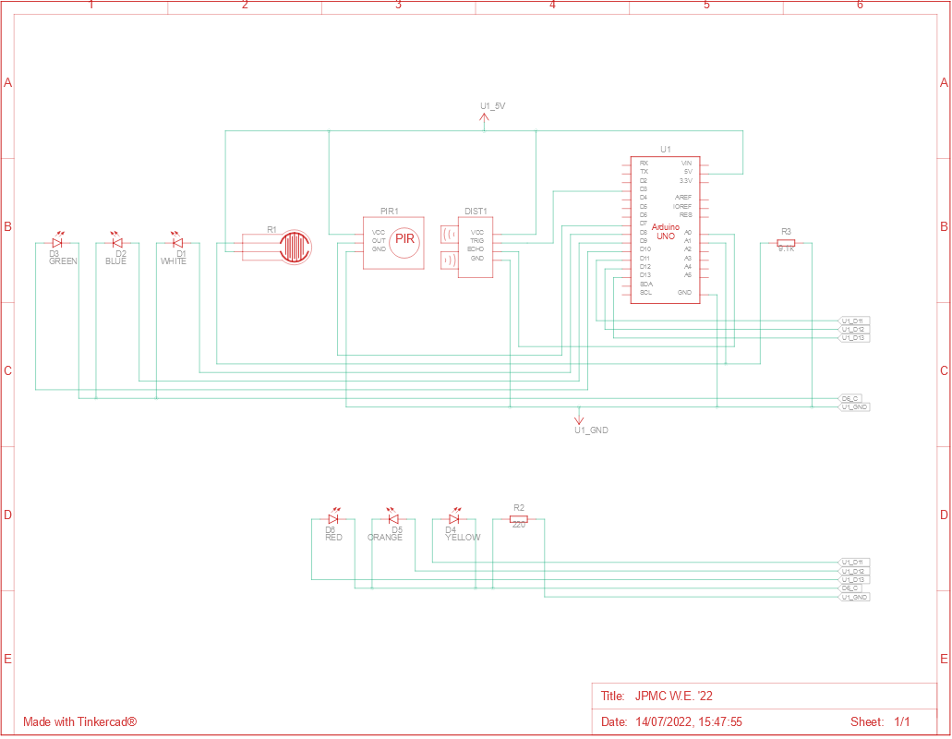

Slide 17
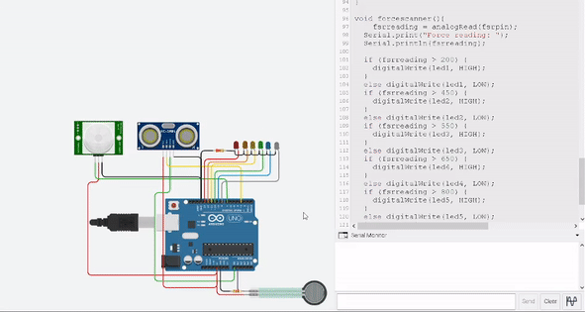
Circuit Animation Example

Slide 18
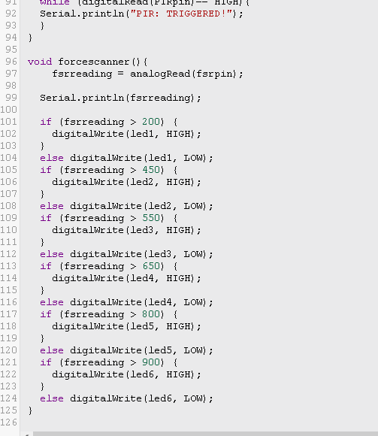
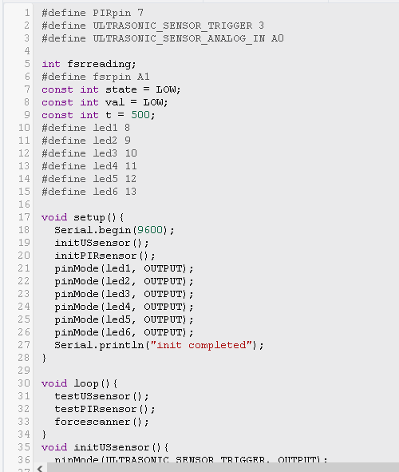
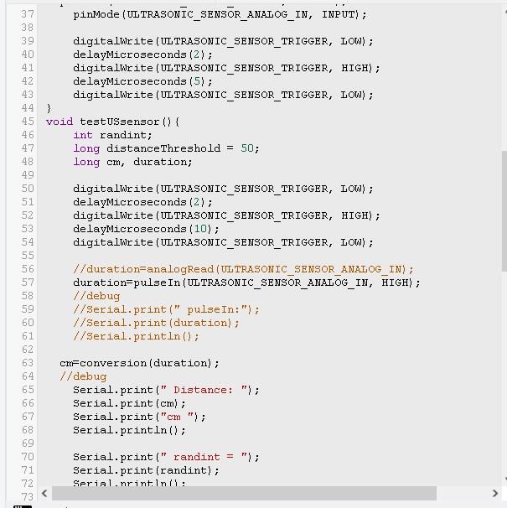
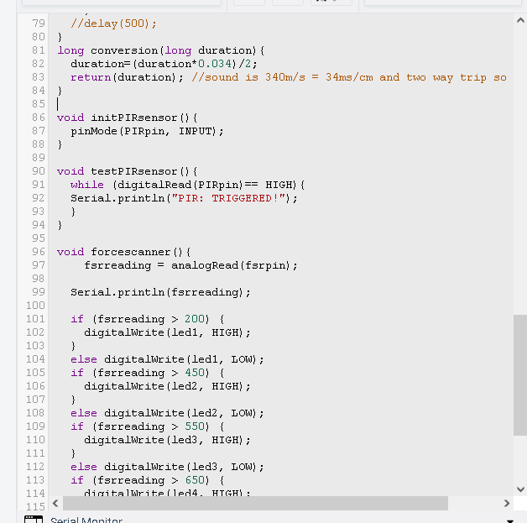
THE CODE

Slide 19
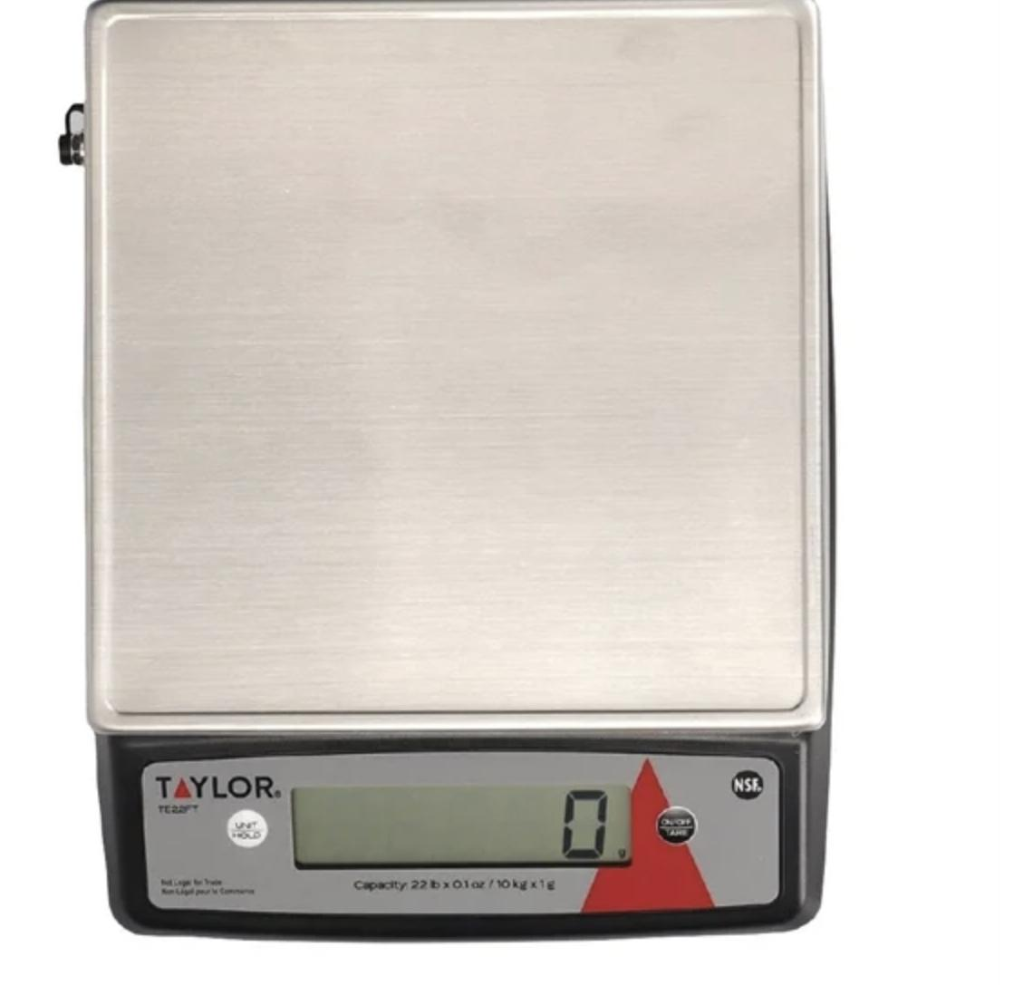
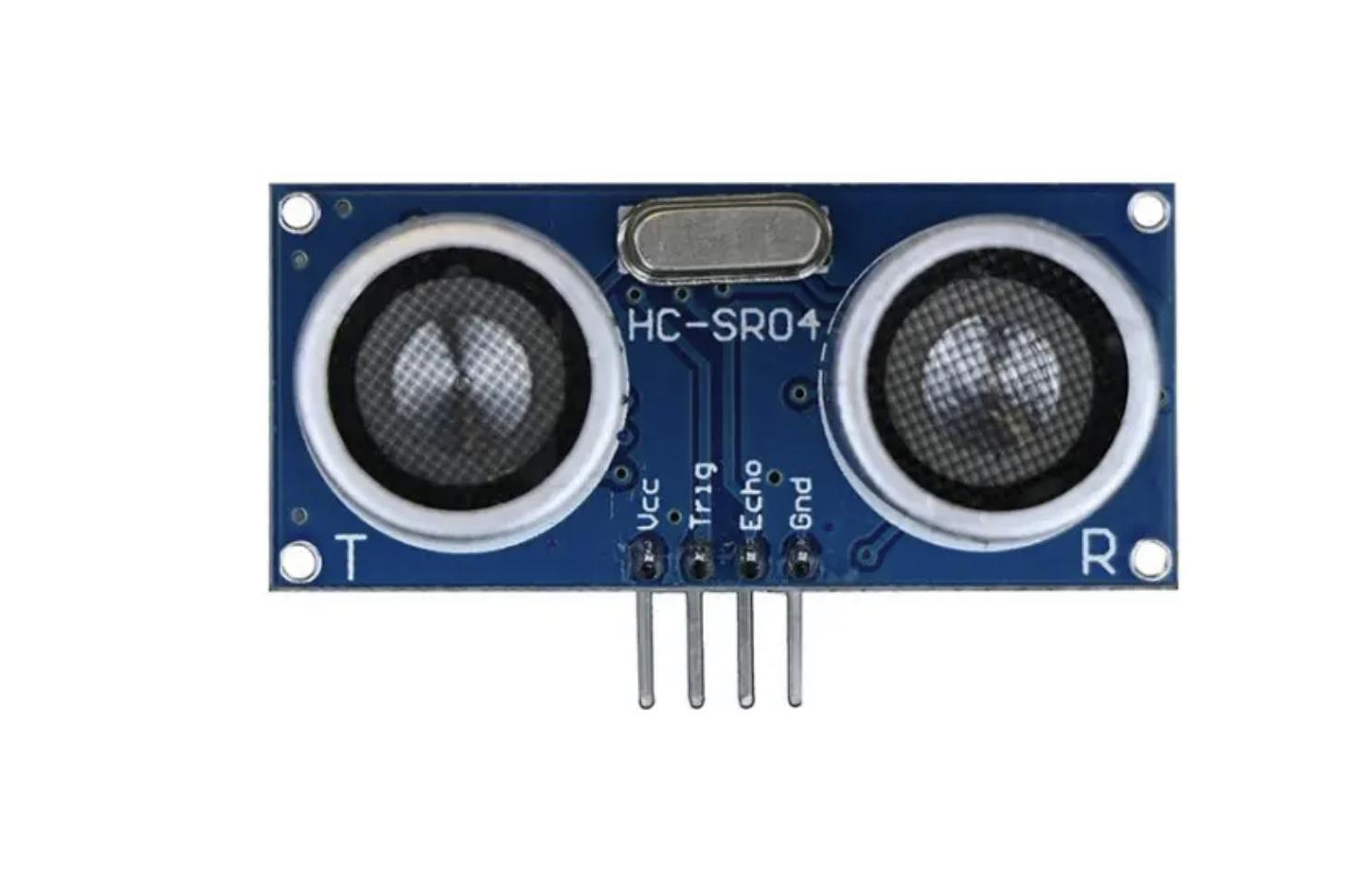
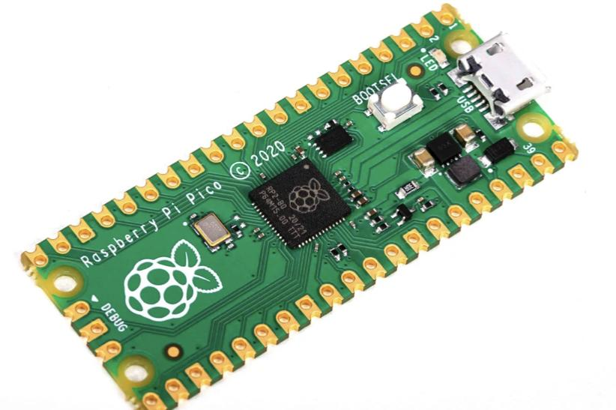
Rough Budgeting
Ultrasound scanner - £60
Mount
Weighted scale -£1728
Sensor - £72
Total price-£1950
Total left- £18,050
Raspberry Pi - £96

Slide 20
Second Phase?

Slide 21
Analysis & Conclusion
Does our project meet the 5 objectives?
How does it tie in with the JP Morgan values and the environmental aims?
Social responsibility within the company
Q&A

